Slide 1
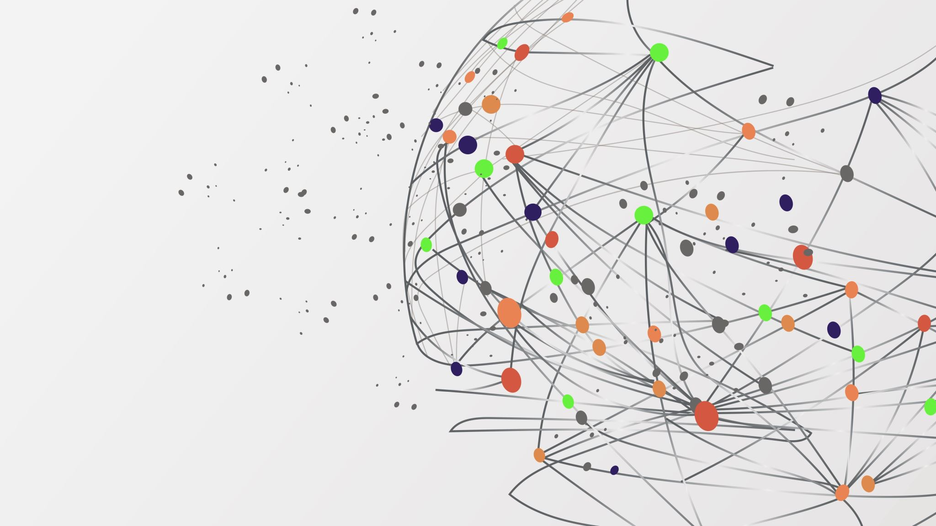
Web Fondamentales
Yassine MESSAI GO MY CODE 2021

Slide 2
How does the web works?
The moment you enter an address in your browser and you hit ENTER, a lot of different things happen:
The URL gets resolved
A Request is sent to the server of the website
The response of the server is parsed
The page is rendered and displayed

Slide 3
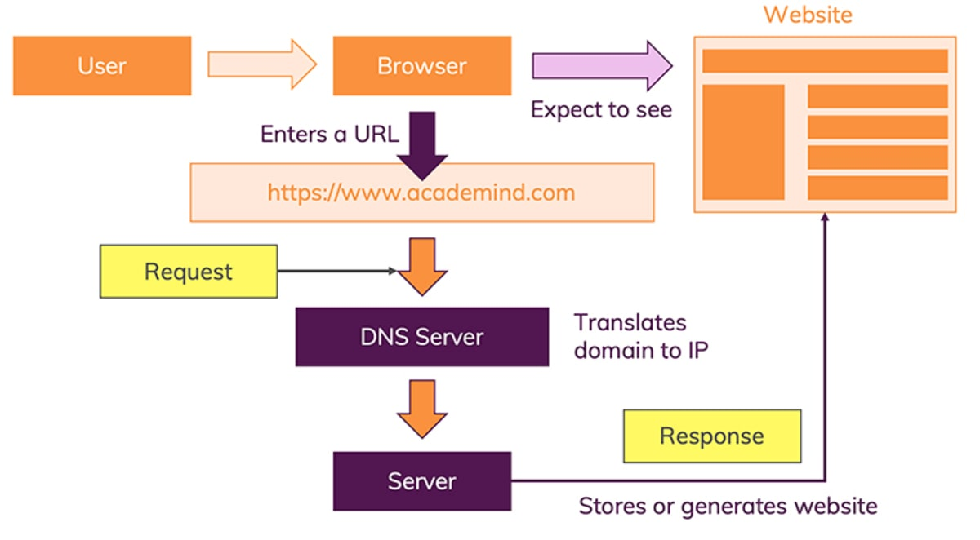
This the schema how does the web works and reacts to the user’s request

Slide 4
What do you need to be a web developer?
While there are no formal or specific qualifications required to become a web developer, a numerate degree in a subject such as maths or science will be useful.
You should also ideally have an aptitude for - or experience of - elements such as:
User experience
User interface
Visual design
Coding languages including HTML and CSS
Frontend web programing languages and skills such as JavaScript, Ajax and web animation techniques
Backend web programing languages such as C# or Java, PHP and Ruby
Design software like Photoshop and Illustrator and Sketch
An understanding of SEO
Web servers and how they function

Slide 5
What’s the role of a web developer?
Web developers typically :
construct the layout of a website,
creating a visually interesting home page and user-friendly design,
may sometimes write content for the website.
- After a website is up and running, developers make sure that the site is functional on all web browsers, testing and updating as needed.

